Slide 1
Data Science
(An Overview)

Slide 2
Enterprises that apply advanced analytics have
33%
more revenue growth
and 12x more profit growth
- IBM
Organizations using predictive metrics will increase profitability by
20%
- Gartner
Vote for Big Data & Analytics
Organizations that embrace analytics are more than
2X
As likely to outperform their peers
- IBM
CXO’s rank analytics as the
#1 Factor
Contributing to organizations competitiveness
- IBM

Slide 3

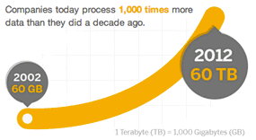

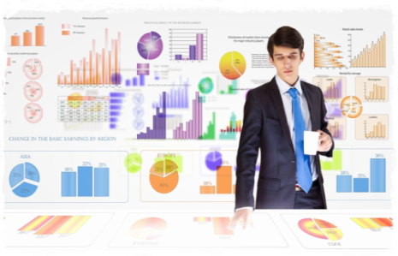

What is Data Science ?
Discovering & communicating patterns and insights in data which are beyond the obvious
Why Data Science
Gain competitive advantage
Synchronize financial & operational strategy
Increase revenues
Tackle regulatory reform
Realize cost efficiency
Manage risk
Improve decision making
The Journey from Data to Business Value
Leading to
Data
Explosion
Multiple Data Sources (Structured & Unstructured)
Use of Analytics
What action to be taken for profits to increase?
Descriptive
What is this quarters contribution margin?
Generate actionable insights & Dollar-Value
Data
Prescriptive
Inquisitive
What will be our sales volume in the next quarter?
Why has this quarters sales gone down?
Predictive

Slide 4
Data Science – Skillsets
“The shortage of data scientists is becoming a serious constraint in some sectors “
- D.J. Patil, HBR – 2012 October issue
“59% of all Data Science and Analytics (DSA) job demand is in Finance and Insurance, Professional Services, and IT."
- forbes.com – 2017 May
“IBM Predicts Demand For Data Scientists Will Soar 28% By 2020."
- forbes.com – 2017 May

Slide 5
Lack of Right Skills & Lack of Thought Process
Yet another programmer ?
Yet another Statistician ?
Yet another Business SME ?
Answer is NO !!!
We need Sherlock Holmes
Solve Business Problems

Slide 6
Course Modules
Data Science - 101
Data Science - 102
Data Science - 103
Basic Math for Machine Learning
Statistics & Probability
Statistical Programming Language
R or Python
Machine Learning Algorithms
Linear Regression Analysis
Logistic Regression Analysis
Decision Trees
Random Forests
KMeans Clustering
Hierarchical Clustering
Association Rule Mining
Intro to Data Visualization / Storytelling
Tableau ( Public version)
Natural Language Processing
Text Preprocessing
Concept of Bag of Words
WordNet
Statistical Programming Language
R or Python
Machine Learning Algorithms
Naïve Bayes Classifier
Support Vector Machines
Topic Modeling
Tfidf Models
Use Cases
Twitter Sentiment Analysis
Document Classification
Deep Neural Networks
Math needed for Deep Learning
Vectors & Matrices
Deep Learning Techniques
Convolutional Networks
Recurrent Neural Networks
LSTM , GRU
Statistical Programming Language
Python Frameworks -TensorFlow , Keras
Use Cases
DL in text mining
DL in image classification
Stock Prediction
1.5
1
1.5
4
2
1
1
Duration
8 Days
4 Days
6 Days
Theory Sessions
50 hours**
Build Social Profile
Create profile on Kaggle.com
Create Github account
Dell EMC² Certification
Need DS 101 + DS 102 + 150 hours of self preparation.
Exam fees ~ $220
Hands On
50 hours
** for DS101 + DS102

Slide 7
Analytics Overview
WHAT IS BUSINESS ANALYTICS?
Involves using advanced technology and algorithms to aggregate, filter and analyze multiple information sources
Includes data mining techniques such as Predictive and Descriptive analytics
Leverages on the wealth of data collected, to enable and supplement decisions making in various business scenarios
WHY INVEST IN BUSINESS ANALYTICS?
To capitalize the data scattered across organization and external data sources to achieve breakthrough in business performance
To use data to discover hidden patterns which can aid in redesigning the business models in conjunction with changing market scenarios
To measure and monitor Financial and Operational business performance, Analyze results, Predict outcomes and Achieve better business results.

Slide 8
What is Predictive Analytics?
Predictive Analytics
Study of algorithms that
improve their performance
at some task
with experience
Optimize a performance criterion using example data or past experience.
Role of Statistics: Inference from a sample
Role of Computer science: Efficient algorithms to
Solve the optimization problem
Representing and evaluating the model for inference

Slide 9
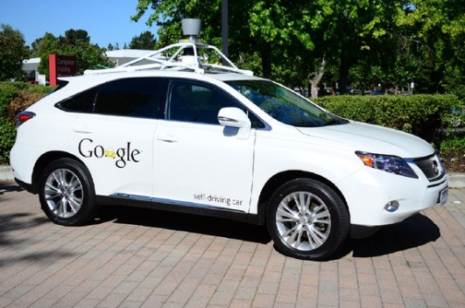
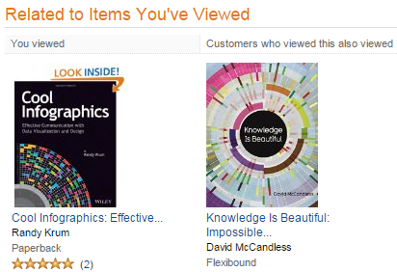
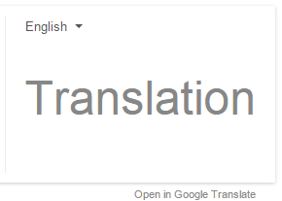
Machine Learning
Machine learning is a branch of Artificial Intelligence with the goal of building computer algorithms that can learn from data and act without a need for being programmed.
Big Data
Predictive Analytics
Cutting-Edge Application of Machine Learning
With an unprecedented amount of data, Google uses machine learning and its processing power to develop highly comprehensive understanding of what’s happening on roads and uses that to drive cars autonomously.
Where do we encounter machine learning in day-today?
The spam filter in emails is built around a machine learning algorithm.
In Google translate , machine learning is trying to learn patterns in data to translate text from one language to another.
On the basis of what is bought on Amazon it suggests what one would like to buy. That is done through machine learning.

Slide 10
Machine Learning - Types
Supervised Learning
Classification – Email spam filter
Regression/Prediction – Predicting property rate basis market factors
Unsupervised Learning
Clustering – Google News
Key Algorithms & Applications
Anomaly Detection – Unusual Credit Card usage in different city / country
Recommender Systems - Amazon Recommendations
NLP/Text Analytics – Google Search Engine

Slide 11



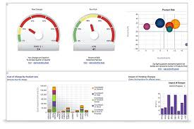



Business Problem Solving End to End Approach
Business Case
Defined Business Problem
Clean Data
Clean the extracted data.
Create new data set as required for analysis.
Explore
Conduct exploratory study of data set.
Identify missing or corrupted records.
Build Model
Design predictive models.
Business Value
Enable decision making from statistical model
Access to database.
Extract Data in programing environment.
Establish understanding of data.
Variable transformations
Descriptive analysis of data – visualization, clustering or dimensionality reduction.
Validation of predictive models.
Finalizing best model for decision making.
Proof-of-Concept
Implement PoC as a Data Product
Publish Analysis and Inference
Structured Data
Data size < 1 GB
Structured / Unstructured Data
Data size > 1 GB
HADOOP

Slide 12

Current Industry Applications
Sentiment Analysis of Twitter data
Prediction of Ratings based on product feedback
Classify best fit resume based on Job description
Social Media analysis of a company
Predicting author of a document
Natural Language Processing
Prediction of Share Values
Housing price prediction
Fraud detection in a transaction
Supermarket recommendation of products
Identify duplicate records in multiple database using Machine Learning techniques
Event Prediction
Prediction of image tags
Product recommendations based on an input image
Implementation of word2vec model in sentiment analysis of Text data
Deep Learning

